Slide 1
DMVPN Fundamentals

Slide 2
DMVPN Overview
Dynamic Multipoint Virtual Private Network, is a Cisco VPN solution for building a scalable Virtual Private Network (VPN).
Operates in a Hub-Spoke Topology.
Allows dynamic routing over incompatible network device.
Send traffic is sent in clear text, providing no data confidentiality.
IPSEC is used to provide data confidentiality, integrity and authentication.
DMVPN is comprised of two components:
Multipoint Generic Routing Encapsulation (mGRE)
Next Hop Resolution Protocol (NHRP)
Notes:
Imcompatible devices refer to TACLANE or non routing devices that do not support the routing protocol.

Slide 3
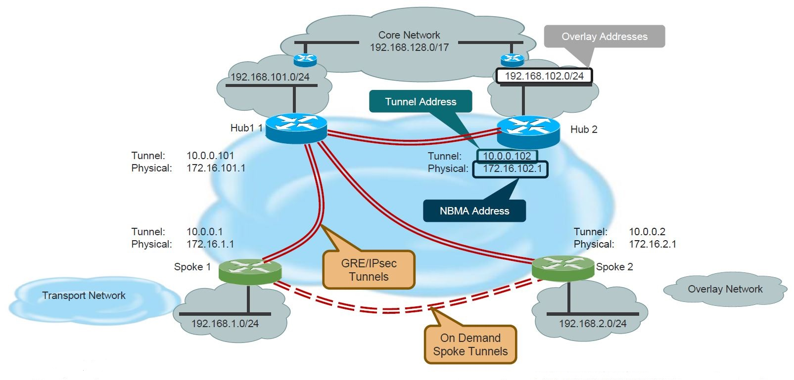
DMVPN Overview
Terminology and Features
Notes:
Highlight here the terminology for the physical address being referred to as the NBMA address. NBMA address is used pervasively in DMVPN to reference the physical address.
Additionally, the tunnel address is referred to as the VPN address.

Slide 4
DMVPN Overview
Advantages include:
Spokes communicate directly with dynamic spoke-to-spoke tunnels
Hub/Spokes are simple to configure
Single multipoint tunnel interface
No changes required for new spokes
Disadvantages include:
All traffic is sent in clear text, providing no data confidentiality
More complex to troubleshoot and understand
Some administrative control lost over dynamic routes
Difficult to control inbound routing metric to Spokes
Difficult to control outbound routing metric to Hub

Slide 5
VPN Types
GRE
site to site
Flex VPN
Improved version of DMVPN
IKEv2
DMVPN
Hub - Spoke
mGRE with NHRP
IKE v1/v2
GET VPN
Group Encrypted Transport (GET)
Used over MPLS
Preserves IP header

Slide 6
DMVPN Phases
DMVPN was released in three phases, with each phase built upon the previous phase with additional functionality
All three phases only require one tunnel interface per router
DMVPN Spokes can use either DHCP or static addressing for the transport and overlay networks

Slide 7
DMVPN Phases
Phase 1: Hub-to-Spoke
The first DMVPN implementation provides a zero-touch deployment for VPN sites. VPN tunnels are only created between spoke and hub sites. Traffic between spokes must travers the hub to reach any other spoke
Phase 2: Spoke-to-Spoke
The second DMVPN implementation incases all of the features of phase 1, while also allowing spoke-to-spoke communication on an on-demand basis
Phase 2 does not allow summarization (next-hop preservation). Therefore, it does not allow for spoke-to-spoke communication. As a result, it does not support spoke-to-spoke communication between different DMVPN networks (Multilevel Hierarchical DMVPN)

Slide 8
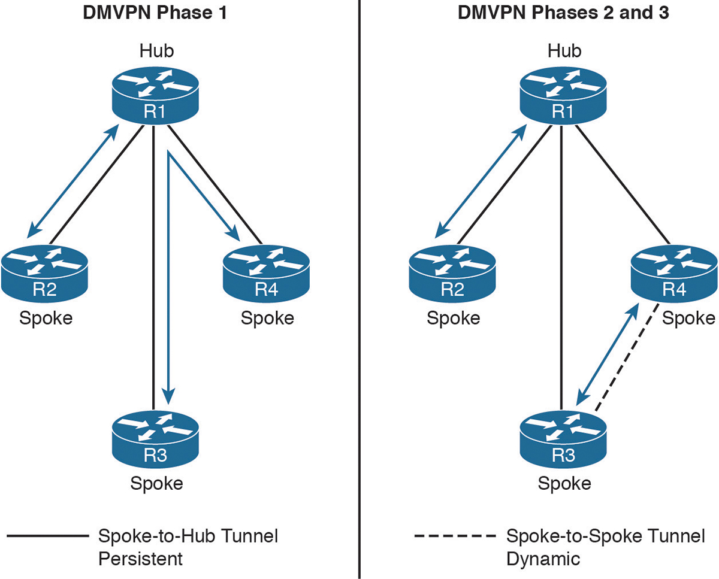
DMVPN Phases

Slide 9
DMVPN Phases
Phase 3: Hierarchical Tree Spoke-to-Spoke
This phase refines spoke-to-spoke connectivity by enhancing NHRP messaging and interacting with the routing table.
Phase 3 allows the hub to send an NHRP re-direct message to the spoke that originated the packet flow. The NHRP re-direct message provides the necessary information so that the originator spoke can initiate a resolution of the destination host/network
NHRP installs paths in the routing table for the shortcuts it creates.
NHRP shortcuts allow a hierarchical tree topology. A regional hub is responsible or managing NHRP traffic and subnets within that region, but spoke-to-spoke tunnels can be established outside that region

Slide 10
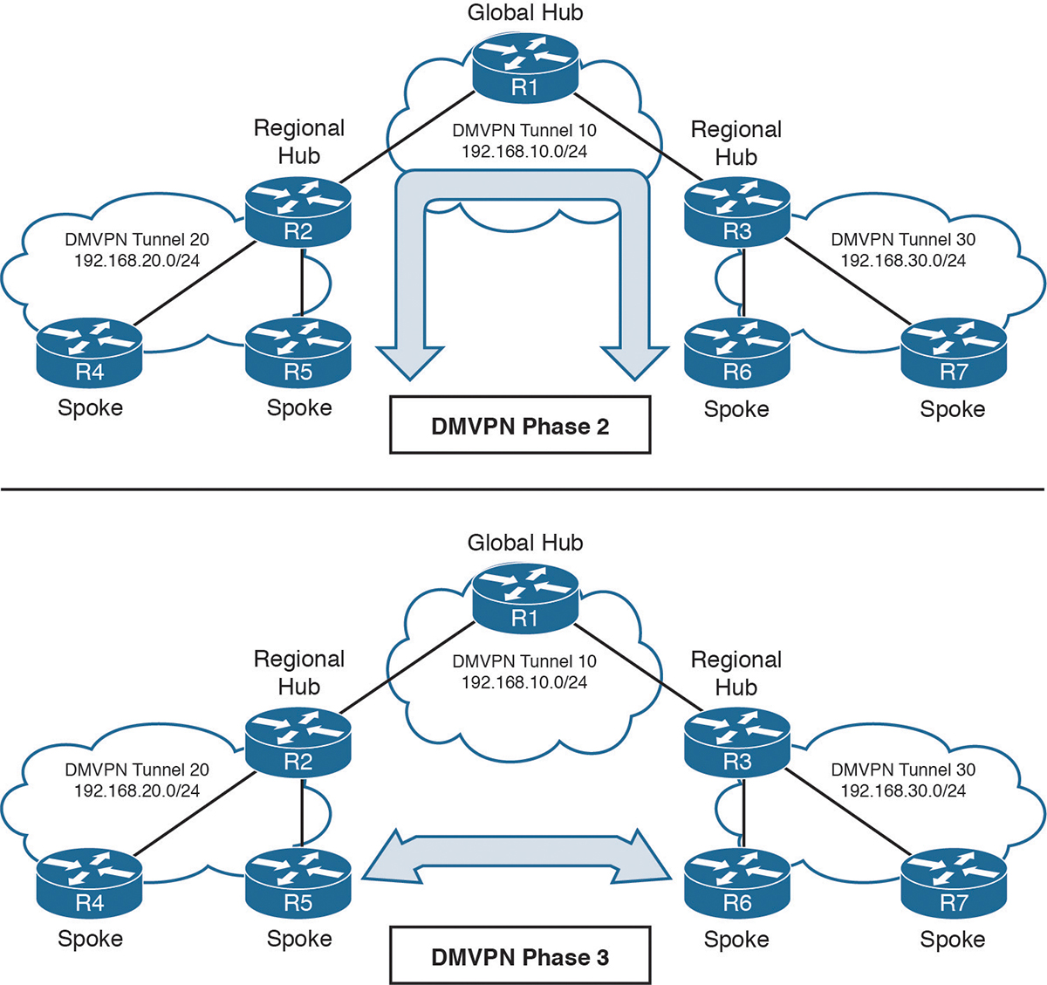
DMVPN Phases

Slide 11
DMVPN Fundamental Phase 1: Generic Routing Encapsulation (GRE)

Slide 12
GRE Overview
Generic Route Encapsulation (GRE) characteristics:
GRE encapsulation uses a protocol type field in the GRE header to support the encapsulation of any OSI Layer 3 protocol.
GRE itself is stateless; it does not include any flow-control mechanisms, by default.
GRE does not include any strong security mechanisms to protect its payload.
IP protocol 47 is used to identify GRE packets.
The GRE header, together with the tunneling IP header, creates at least 24 bytes of additional overhead for tunneled packets.
Notes:
Generic Routing Encapsulation (GRE) is a tunneling protocol developed by Cisco Systems that can encapsulate a wide variety of network layer protocols inside virtual point-to-point links over an Internet Protocol network.
GRE is defined as an IETF standard.

Slide 13
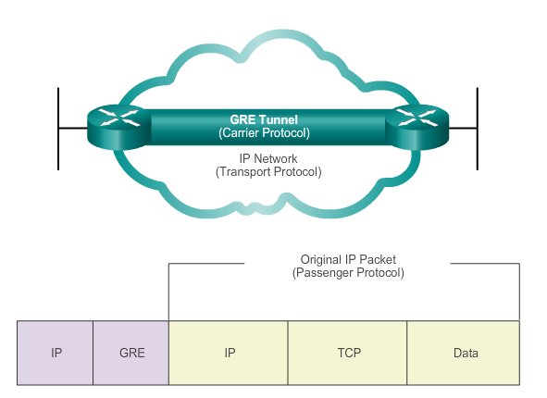
Characteristics of GRE
Basic, non-secure, site-to-site tunnel
Encapsulates a wide variety of protocol packet types inside IP tunnels
Creates a virtual point-to-point link to routers at remote points, over an IP internetwork

Slide 14
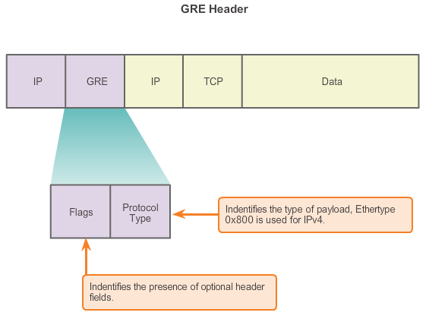
Characteristics of GRE

Slide 15
GRE Configuration
GRE tunnel requirements
IP Address
Tunnel Source
Tunnel Destination
Valid route to destination
GRE Tunnels are stateless

Slide 16
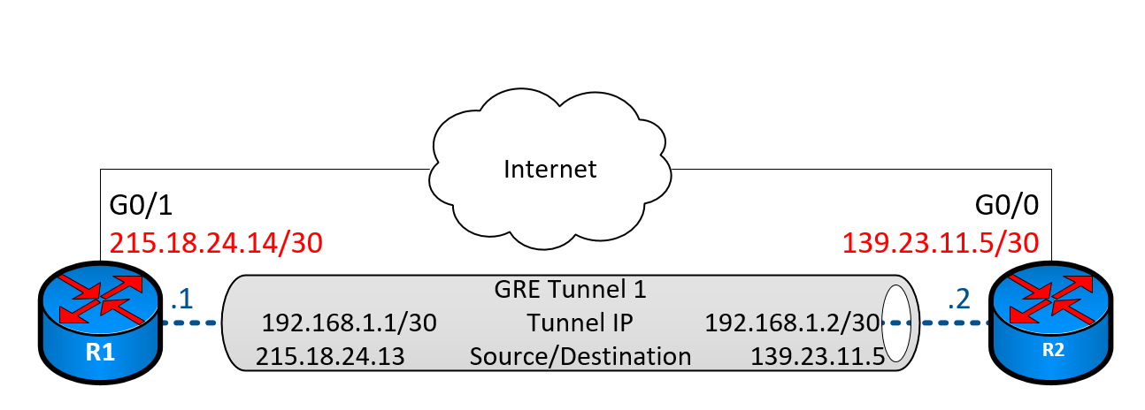
GRE Configuration
Router 1 Configuration
R1(config)#interface Tunnel 1 Create the tunnel interface
R1 (config-if)#ip address 192.168.1.1 255.255.255.252 Defines tunnel IP address
R1(config-if)#tunnel source GigabitEthernet 0/1 Define the tunnel source
R1(config-if)#tunnel destination 123.45.67.8 Define the tunnel destination
R1(config-if)#tunnel mode gre ip Define tunnel mode
R1(config)#ip route 123.45.67.8 255.255.255.255 122.33.44.5 Define route to destination
ISP
122.33.44.5
122.33.44.6/30
123.45.67.9/30
.14
123.45.67.9
122.33.44.6

Slide 17
GRE Configuration
Tunnel Baseline Configuration
Interface TunnelXX
no ip redirects
no ip proxy-arp
ip mtu 1375
ip tcp adjust-mss 1315
bandwidth 3072
delay 500
qos pre-classify
load-interval 30
Basic Security Commands
Lowers MTU and TCP Segment sizes to take account tunnel overhead
EIGRP Metrics
Same for all GRE tunnel interfaces
QoS Preclassify: Encapsulated packet uses QoS marking in original packet
Notes:
Explanation of each for better understanding

Slide 18
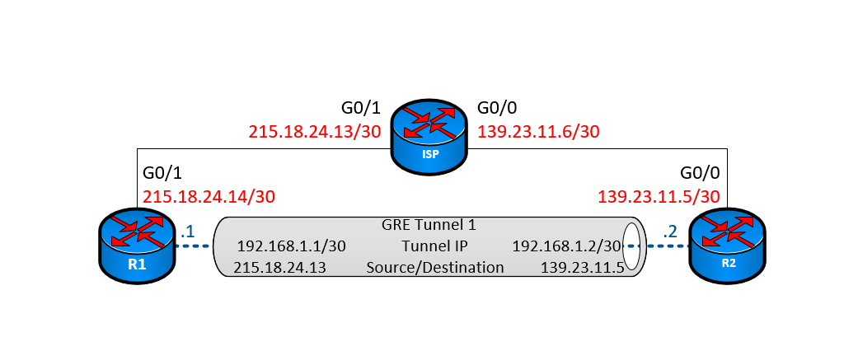
GRE LAB
ISP
122.33.44.4
interface tunnel {XX} Create the tunnel interface
ip address {IP-address Subnet Mask} Defines tunnel IP address
tunnel source {GigabitEthernet X/X} Define the tunnel source
tunnel destination {destination IP-address} Define the tunnel destination
tunnel mode gre ip Define tunnel mode, Optional
exit
ip route {destination Network} {Destination Mask} {Next-Hop IP-Address}
122.33.44.5/30
123.45.67.10/30
122.33.44.6/30
123.45.67.9/30
122.33.44.6
123.45.67.9

Slide 19
QUESTION
Question:
What are the four requirements to configure a GRE tunnel?
Answer:
IP Address
Tunnel Source
Tunnel Destination
Valid route to destination

Slide 20
DMVPN Fundamental Phase 2: Multipoint Generic Routing Encapsulation (mGRE)

Slide 21
mGRE Overview
Multipoint GRE (mGRE) is a protocol that enables point-to-multipoint tunneling
mGRE protocol is used in DMVPN of creating dynamic VPN networks with multiple sites without having to pre-configure the tunnel end-points for each peer statically.
Encapsulates a variety of Layer-3 protocols
Does not provide protection, Sends data in the clear
Different from GRE, mGRE tunnels will not specify the destination in a tunnel command but will use another protocol (NHRP) to establish multiple tunnel end-points.

Slide 22
mGRE Configuration
mGRE requirements
IP Address
Tunnel Source
Mode set to GRE multipoint
Valid route to destination
Best practice for extra security
Tunnel key
Best practice for quality
Adjust MTU size
Adjust TCP adjust-mss

Slide 23
mGRE Configuration
mGRE for Hub and spoke
Interface Tunnel 1
Creates Tunnel Interface
ip address 10.0.0.X/24
Configures IP address for tunnel, X replaced by appropriate IP
tunnel source “G0/0 or physical IP address”
Defines tunnel source
tunnel mode gre multipoint
Defines tunnel as a mGRE tunnel.
tunnel key 456
Defines tunnel key, in plain text, for extra security.
ip MTU 1400
Defines the Maximum Transmission Unit or packet size.
Ip tcp adjust-mss 1360
Defines maximum TCP segment size, should be 40 less than MTU to prevent fragmentation.
Notes:
In green is the information that must match on both Hub and spoke.

Slide 24
DMVPN Fundamental Phase 3: Next Hop Resolution Protocol (NHRP)

Slide 25
NHRP Overview
Next Hop Resolution Protocol (NHRP)
Address Resolution Protocol (ARP)-like protocol
Dynamically maps Non-Broadcast Multiple Access (NBMA) networks to the virtual (GRE/mGRE) IP address
Controls the formation of tunnels
Allowing traffic to be sent to the correct router.
NHRP Terms
NBMA= Physical interface of router “Outside interface”
Virtual= Tunnel IP address
NHRP works in a Server/Client relation
Next Hop Server (NHS), Hub Router
Next Hop Client (NHC), Spoke Routers
Notes:
IETF RFC 2332 and RFC 2333

Slide 26
NHRP Configuration
NHRP requirements
NHRP Network-id
NHRP Map entry
Best practice for extra security
NHRP Authentication
Best practice for quality improvement
NHRP Redirect(Hub)
NHRP shortcut (Spoke)

Slide 27
NHRP Hub Configuration
NHRP Hub
ip nhrp network-id 123
Identifies NHRP Network, must be same on spokes.
ip nhrp map multicast dynamic
Creates multicast mapping to dynamically allow any NBMA interface to connect
ip nhrp authentication Abcd!@34
Provide Authentication , must be same on spokes
ip nhrp redirect
Signals to spoke to generate resolution request. This is used to dynamically build tunnels between spoke vice relaying traffic through the hub.
Notes:
In green is the information that must match on both Hub and spoke.

Slide 28
NHRP Spoke Configuration
NHRP Spoke
ip nhrp network-id 123
Identifies NHRP Network, must be same on hub.
ip nhrp nhs 10.0.0.1
Allows Spoke to register with Hub
ip nhrp map 10.0.0.1 200.0.0.1
Allows Spoke to reach the NHS
Maps Hub’s tunnel IP address to it’s physical address
ip nhrp map multicast 200.0.0.1
Creates multicast mapping points to tunnel to the NBMA interface
ip nhrp authentication Abcd!@34
Provide Authentication, must be same on hub.
ip nhrp shortcut
Allows spoke to generate resolution request after redirect is received from the hub
Notes:
In blue is the tunnel network or the virtual/logical network.
In red is the NBMA= physical IP address/outside interface.
In green is the information that must match on both Hub and spoke.

Slide 29
QUESTION
Question:
What are the two sets of IPs that NHRP maps together
Answer:
NBMA= Physical interface of router “Outside interface”
Virtual= Tunnel IP address

Slide 30
mGRE with NHRP together
SPOKE 1
Interface Tunnel 1
Creates Tunnel
ip address 10.0.0.2/24
Configures IP address for tunnel, X replaced by appropriate IP
ip nhrp network-id 123
Identifies NHRP Network, must be same on hub.
ip nhrp nhs 10.0.0.1
Allows Spoke to register with Hub
ip nhrp map 10.0.0.1 200.0.0.1
Allows Spoke to reach the NHS
Maps Hub’s tunnel IP address to it’s physical address
ip nhrp map multicast 200.0.0.1
Creates multicast mapping points to tunnel to the NBMA interface
ip nhrp authentication Abcd!@34
Provide Authentication, must be same on hub.
ip nhrp shortcut
Allows spoke to generate resolution request after redirect is received from the hub
Tunnel source 180.0.10.65 (or G0/x)
Defines tunnel source
Tunnel mode gre multipoint
Defines tunnel as a mGRE tunnel.
Tunnel key 456
Defines tunnel key, in plain text, for extra security.
ip MTU 1400
Defines the Maximum Transmission Unit or packet size to prevent fragmentation.
Ip tcp adjust-mss 1360
Defines maximum TCP segment size, should be 40 less than MTU.

Slide 31
DMVPN LAB
Hub
Interface Tunnel 1
ip address “Hub Virtual”
ip nhrp network-id xxx
ip nhrp map multicast dynamic
ip nhrp authentication ########
ip nhrp redirect
Tunnel source “Physical interface or IP”
Tunnel mode gre multipoint
Tunnel key XXX
ip MTU 1400
Ip tcp adjust-mss 1360
no ip next-hop-self eigrp XX
no ip split-horizion eigrp XX
SPOKE
Interface Tunnel 1
ip address “Spoke Virtual”
ip nhrp network-id xxx
ip nhrp nhs “Hub Virtual”
ip nhrp map “Hub Virtual” ”Hub Physical”
ip nhrp map multicast ”Hub Physical”
ip nhrp authentication ########
ip nhrp shortcut
Tunnel source “Physical interface or IP”
Tunnel mode gre multipoint
Tunnel key XXX
ip MTU 1400
Ip tcp adjust-mss 1360
ip nhrp nhs “Hub Virtual” nbma “Hub Physical” multicast

Slide 32
DMVPN Summary
Dynamic Multipoint Virtual Private Network, is a Cisco VPN solution for building a scalable Virtual Private Network (VPN).
Operates in a Hub-Spoke Topology.
Allows dynamic routing over incompatible network device.
Send traffic is sent in clear text, providing no data confidentiality.
IPSEC is used to provide data confidentiality, integrity and authentication.
DMVPN is comprised of two components:
Multipoint Generic Routing Encapsulation (mGRE)
Next Hop Resolution Protocol (NHRP)

Slide 33
QUESTION
Question:
What are the two componets of DMVPN?
Answer:
Multipoint Generic Routing Encapsulation (mGRE)
Next Hop Resolution Protocol (NHRP)

